Slide 1
CS 3330 Exam 1 Review
By: D.J. Anderson

Slide 2
int array[10] = {3, 5, 9, 17, 33, 65, 129, 257, 513, 1025}; int *z = array + 5;
z[0] = _____ *(z+2) = _____ *z+2 = _____
z[0] = _____ *array = ______________________
z += 4;
*z -= 2;
z -= 3;

Slide 3
Powers of 2
2 ^ (0-9) = B Suppose the number in the
2 ^ (10-19) = KB exponent is two digits.
2 ^ (20-29) = MB The first digit tells you
2 ^ (30-39) = GB the letter: K, M, G, T.
2 ^ (40-49) = TB
2^0 = 1 2^1 = 2 2^2 = 4 The second digit tells you
2^3 = 8 2^4 = 16 2^5 = 32 the number: 1, 2, 4, 8, 16,
2^6 = 64 2^7 = 128 32, 64, 128, 256, 512.
2^8 = 256 2^9 = 512
Ex. 2 ^ 36 = _____

Slide 4


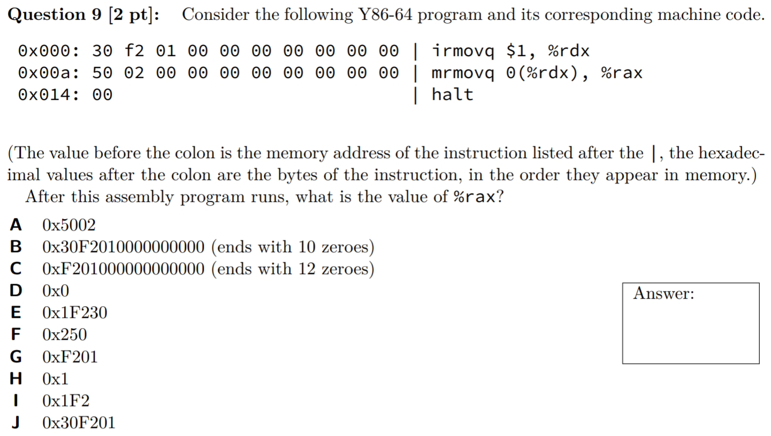




Slide 5
RISC vs CISC

